Slide 1

IST 261 (Fall 2019)
Application Development Design Studio I
Programming
Phil O'Connell
pxo4@psu.edu

Slide 2
What is a Program?
A set of instructions for a computer
Like a recipe is a set of instructions for a meal
Accomplishes a task
Solving a problem, playing a game, doing your taxes, control a hardware device, etc…
A computer language is used to write the instructions

Slide 3
Computers Are Dumb
Sometimes they appear smart
But that's because they're fast
Programmers tell them what to do
Programmers teach them how to interact with
Hardware (operating systems, drivers)
People (user interfaces)
Software (middleware)

Slide 4
Early Programmers
The following are some prominent names in the history of computer programming
But just a small portion of the many pioneers

Slide 5
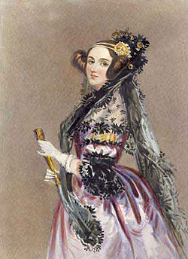
Early Programmers
Ada Lovelace (1815-1852)
Widely-considered the first computer programmer
In 1843, she wrote an algorithm for use by a computer
That computer (called the Analytical Engine) was to be built by Charles Babbage, but he ran out of money
Algorithm A set of well-defined steps that can be used in a program

Slide 6
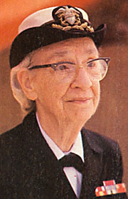
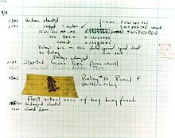
Early Programmers
Admiral Grace Hopper (1906-1992)
Invented the language "A-0" in 1952
Popularized the term "debugging"
"First actual case of bug being found"

Slide 7
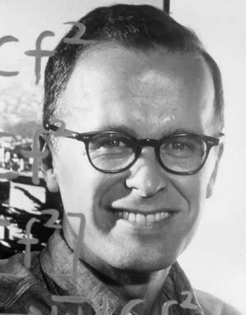
Early Programmers
John Backus (1924-2007)
Invented Fortran in 1957
Formula translating
Was the most popular language for scientific applications
Still in use today
Latest version as of 2010

Slide 8
Early Programmers
Admiral Grace Hopper (1906-1992)
One of the inventors of COBOL (1959)
Common Business Oriented Language
As Fortran was used for science apps, COBOL was used for business apps

Slide 9
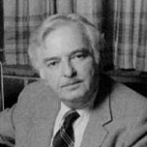
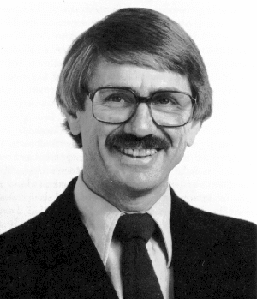
Early Programmers
Invented BASIC in 1964
Beginner's All-Purpose Symbolic Instruction Code
Foundation for Visual Basic and VB .Net
John Kemeny (1926-1992)
Thomas Kurtz (1928-)

Slide 10
Java Pedigree
Java has a pedigree of other languages
These are some of those languages
BCPL → B → C → C++ → Java
Starting in the mid 1960s…

Slide 11
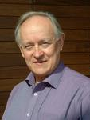
Pedigree of Java
BCPL → B → C → C++ → Java
Created in 1966
Martin Richards (1940-)
What it looks like:
GET "LIBHDR" LET START () BE $( WRITES ("Hello, world!*N") $)

Slide 12
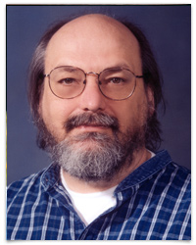
Pedigree of Java
BCPL → B → C → C++ → Java
Created in 1969
Ken Thompson (1943-)
What it looks like:
main( ) {
extrn a;
putchar(a);
}
a 'Hello, world!'

Slide 13
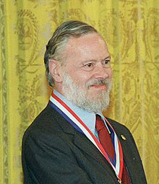
Pedigree of Java
BCPL → B → C → C++ → Java
Created in 1972
Dennis Ritchie (1941-2011)
What it looks like:
#include <stdio.h>
int main(void) {
printf("Hello, world!\n");
return 0;
}

Slide 14
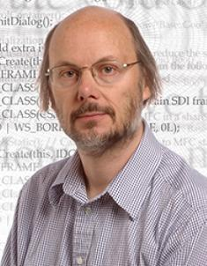
Pedigree of Java
BCPL → B → C → C++ → Java
Created in 1983
Bjarne Stroustrup (1950-)
Fast like C
But it's object oriented
What it looks like:
int main(){
std::cout << "Hello, world!";
}

Slide 15
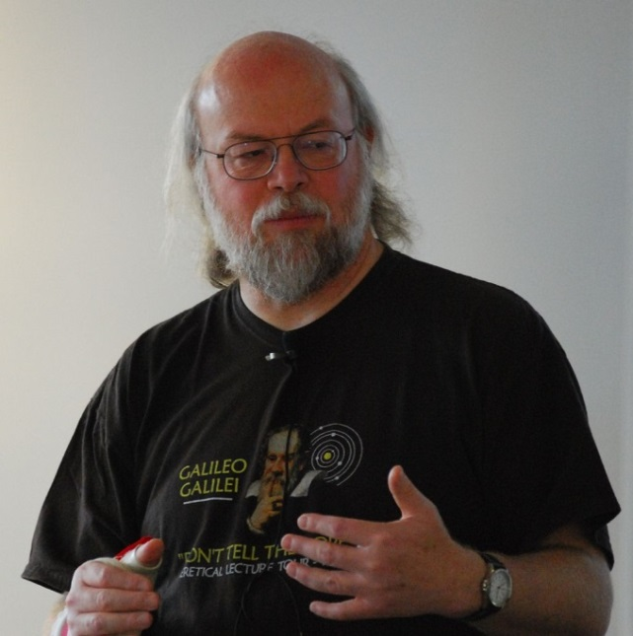
Pedigree of Java
BCPL → B → C → C++ → Java
Created in 1995
James Gosling (1955-)
Has aspects of C and C++
Object-oriented, Portable
What it looks like:
public static void main(String[] args) { System.out.println("Hello, world!");
}

Slide 16
Why Was Java Invented?
Features that most languages lacked were
Portability (WORA: Write Once, Run Anywhere)
Natively handling network communication
Good security (network and file restrictions)
Those were important because of
Increased use of networked computers
Internet
Intranets (computers within an organization)

